Slide 1
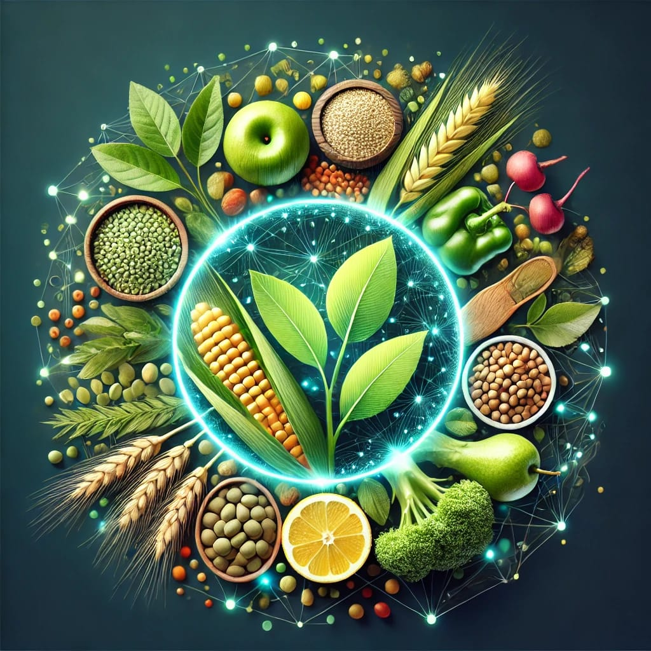
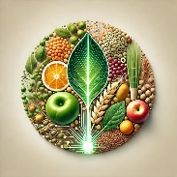
Advancing Nutrition Science Through GeminiAI
Presented By:
Sadam Kaveri
Utkuri Nagarani
Giragani Meghana
Pasula Ashlesha

Slide 2
Problem Statement
The current nutrition science practices rely on generalized dietary guidelines that fail to meet individual needs.
Difficulty in predicting nutrient deficiencies, health risks, and metabolic responses in real-time.
Limited integration of large-scale nutrition data and advanced AI technologies for customized recommendations.

Slide 3
Proposed Solution
NutriGen is a web-based application powered by Google Generative AI (GenAI) that provides users with detailed nutritional insights and AI-driven meal planning. The solution addresses the challenge of creating personalized, nutritionally balanced meal plans while offering instant food analysis.

Slide 4
Technologies Used
Python – Main programming language for development
Streamlit – For creating the interactive web app UI.
Google Generative AI
API key

Slide 5


